Slide 1
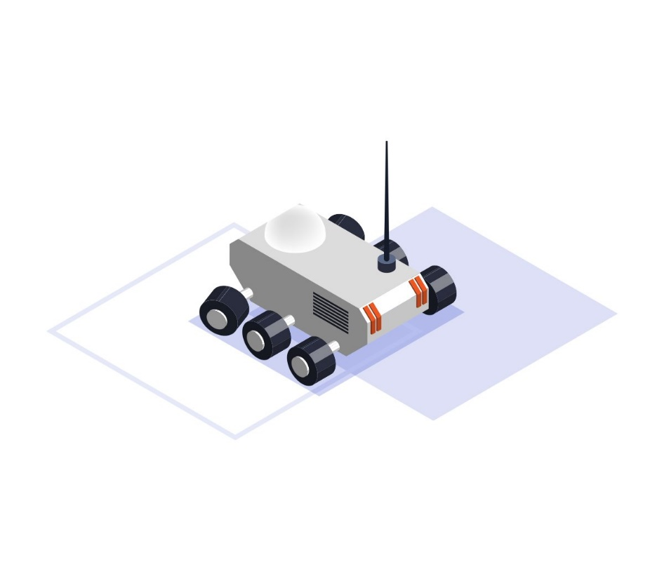
Problem Statement: Drone Simulation
From package delivery to search-and-rescue to research applications and more, autonomous drones are helpful tools in a variety of (sometimes life-saving) applications.
Using a simulated environment and quadcopter, or drone with 4 propellors, you are tasked with designing a path-following algorithm to help the drone fly autonomously. Each environment will have a different track for your drone to follow, so use the available sensors and motors to fly along the path to victory!

